Slide 1
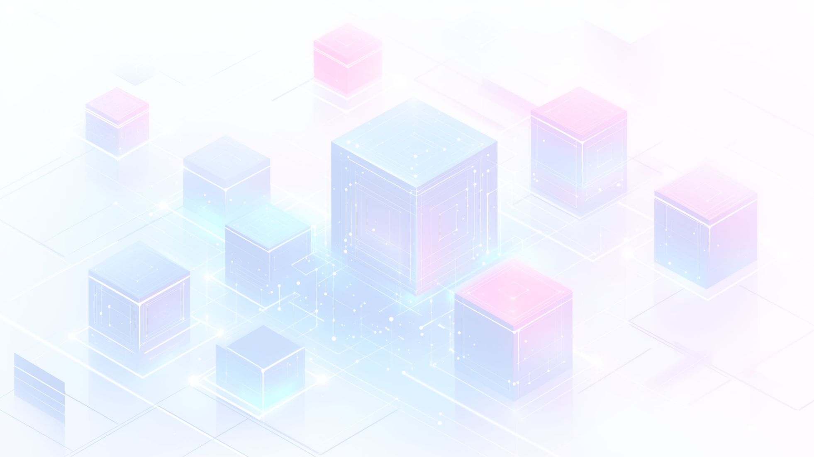

Front-End Development Overview
The front-end development is a powerful web development framework that integrates five key technologies: HTML, CSS, JavaScript, Bootstrap and React. Together, these components enable developers to build dynamic and robust web applications. This presentation explores each part of the stack, highlighting their individual roles and how they collaborate to enhance the development process.

Slide 2
Self Introduction
Hello, my name is Farman Ansari, and I’m From Nadiad.
I have completed my Bachelor of Computer Applications (BCA) and I am currently pursuing Front-End Development training at TOPS Technologies.
I am a passionate about Front-End Development with a strong foundation in both front-end technologies including JavaScript.js, Bootstrap, CSS, HTML, HTML, CSS, and Bootstrap and React. I have hands-on experience building responsive, user-friendly web applications, and I’m comfortable working with version control tools like Git and deploying applications through platforms like Vercel.
📂 Projects:
MediNest Clone– Developed a fully responsive healthcare-related website “Medinest” using HTML, CSS, and Bootstrap.
Nivia Sport Clone– Simple Design with Skill including like Html And Css.
🌱I am constantly working to sharpen my skills and stay updated with the latest web technologies, with a strong focus on writing clean, scalable code and delivering quality solutions.

Slide 3

Understanding the Front-End Development
Definition
Components
Popularity
Front-End is a framework for web applications.
Includes HTML, CSS, JavaScript, Bootstrap and React.
Widely adopted for its flexibility and speed.

Slide 4
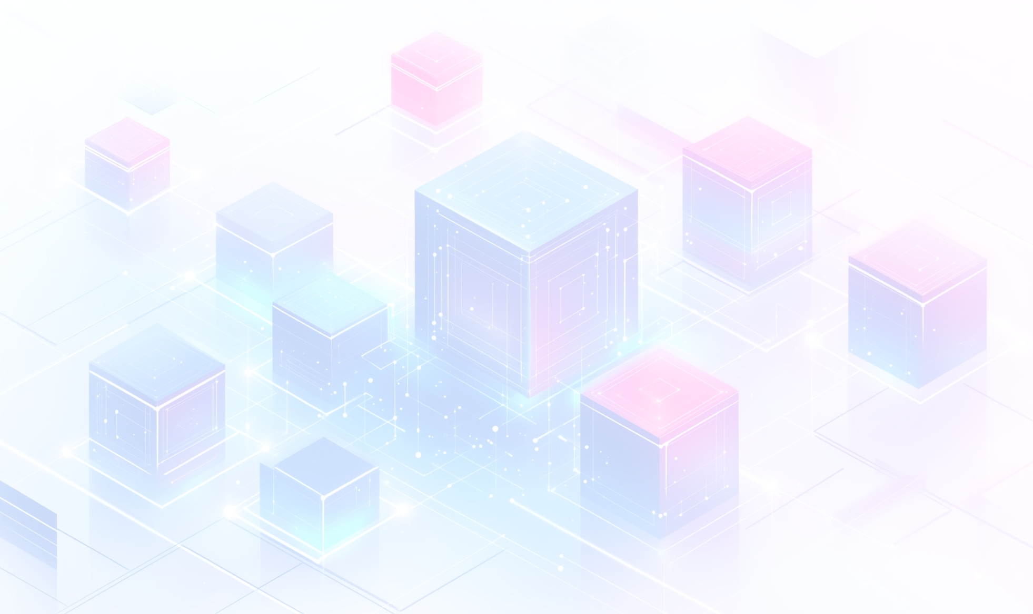
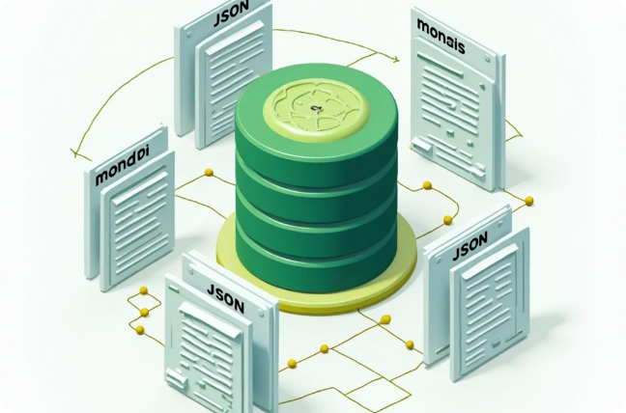
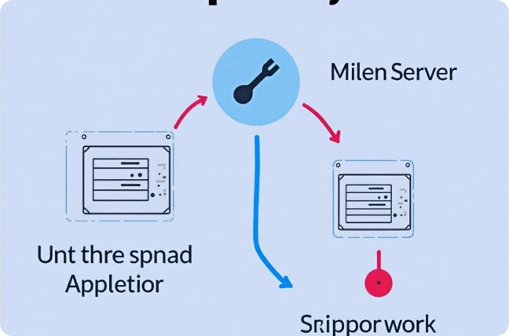


Front-End Development Components
HTML
CSS
Html is Hyper Text Markup Language
Web application framework for Bootstrap
JavaScript
Bootstrap
JavaScript library for building UIs
JavaScript runtime for server-side coding

Slide 5
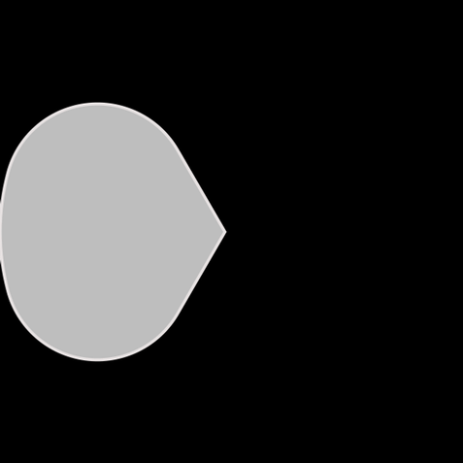
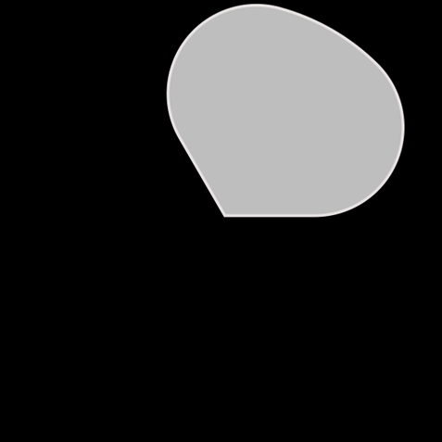

HTML Overview
Builds the foundation of any website
Uses tags to organize content
2
HTML gives structure and meaning to a web page by defining elements like headings, paragraphs, images, and links.
1
3
Supports semantic elements for SEO and accessibility

Slide 6

CSS Overview
CSS, which means Cascading Style Sheets. CSS is used to style and design the web pages — like colors, fonts, and layouts. It also helps in making the website responsive, so it looks good on all devices. Using CSS, we can also create animations and transitions to make the UI more attractive.

Slide 7
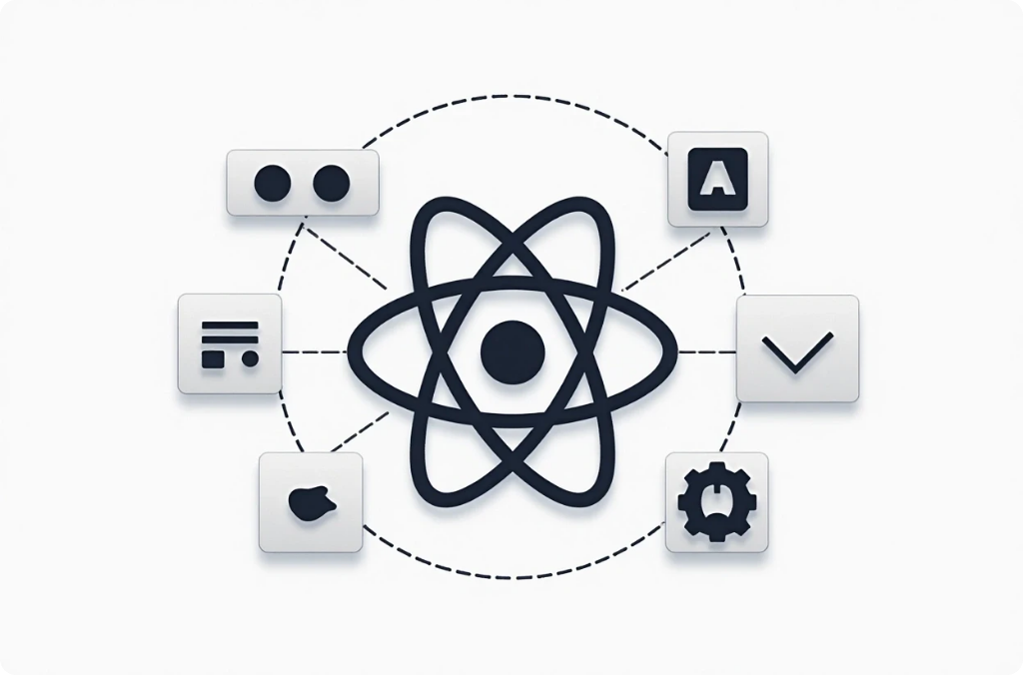
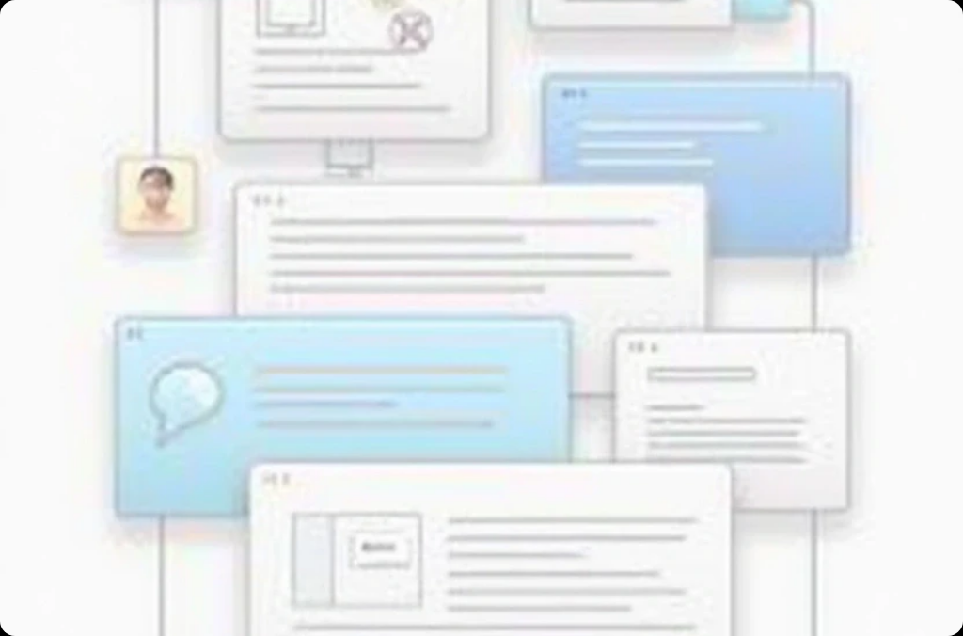
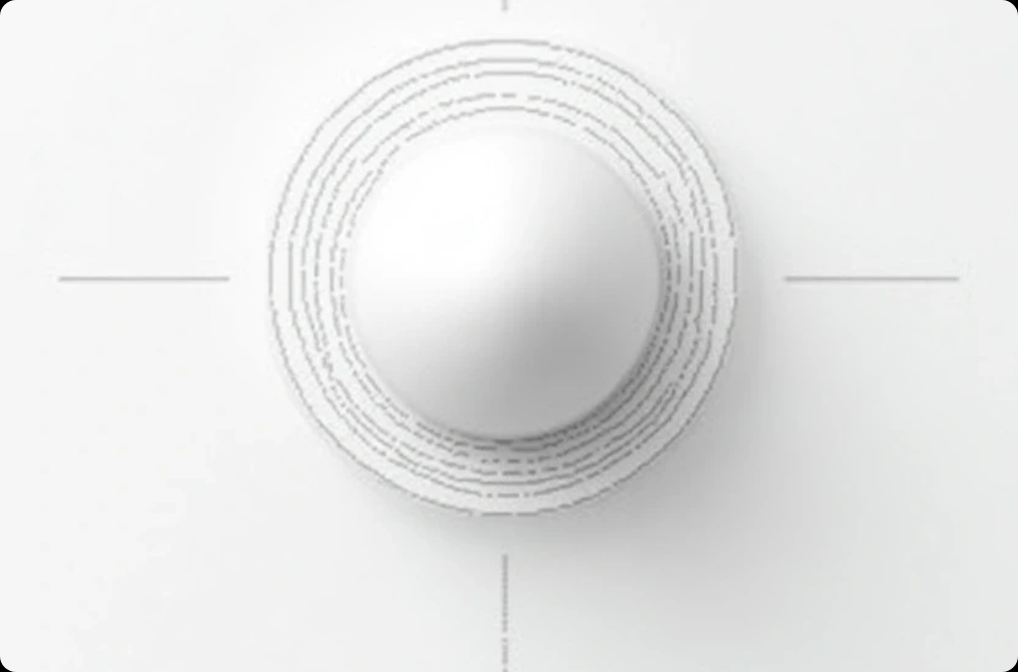
React Overview
Frontend Library
Component-Based Architecture
Virtual DOM
React is a JavaScript library for building user interfaces, particularly single-page applications where data changes dynamically without refreshing the page.
React uses a Virtual DOM to optimize rendering performance, ensuring that only changed components are updated in the browser.
It promotes building reusable UI components, enhancing code maintainability and organization.

Slide 8





Bootstrap Overview
Bootstrap is a powerful tool for developers, enabling JavaScript to be used on the server-side. Its event-driven architecture facilitates efficient handling of numerous connections, while npm provides access to a wide array of libraries that enhance development speed.
2
Event-Driven Architecture
Efficiently handle multiple connections with a non-blocking I/O model.
JavaScript Runtime
Run JavaScript on the server-side for full-stack development.
1
Package Management
Access thousands of libraries through npm for rapid development.
3

Slide 9


Benefits of Using Front-End Development
Fast Career Growth
High Demand & Job Opportunities
Creative and Visual Work
Front-end developers are in great demand across IT companies, startups, and product-based firms.
Front-end development lets you see your work come alive — you design, build, and style websites that users directly interact with.
Because front-end technologies evolve quickly, developers who keep learning can grow fast in their careers.

Slide 10
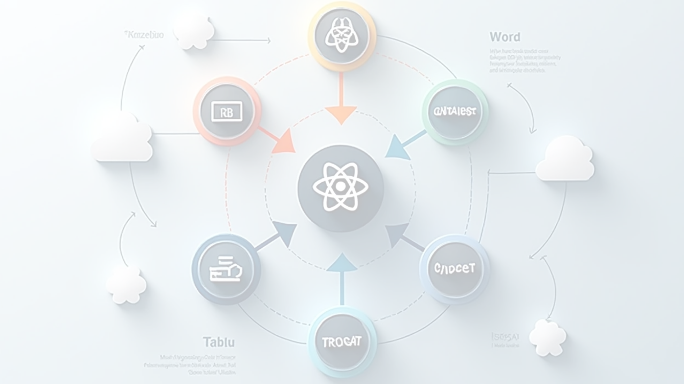

Use Cases and Applications of Front-End Development
Single Page Applications (SPAs)
Real-Time Applications
E-commerce Platforms
Applications like chat apps and collaborative tools benefit from the stack's ability to handle real-time data updates.
The flexibility and scalability of the front-end development make it suitable for building complex e-commerce solutions.
Front-End is ideal for SPAs where a smooth and fast user experience is crucial, such as social media platforms.

Slide 11
Thank You

